Slide 1

Java Programming – Part II
Present By
Poovaragavan Velumani
Java trainer
+91-6385260317
Email id : msgtovpragavan@gmail.com

Slide 2

Object-Oriented Programming (OOPs) – Part II

Slide 3

Inheritance in Java OOPs
Java Inheritance is a mechanism in which one class acquires the property of another class. In Java, when an “Is-A” relationship exists between two classes, we use Inheritance.
The parent class is called a super class and the inherited class is called a subclass.
The keyword extends is used by the sub class to inherit the features of super class.

Slide 4
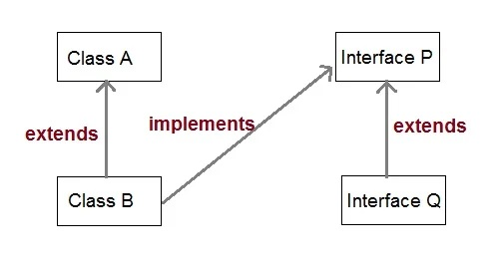
Types of Inheritance
Single Inheritance
Multilevel Inheritance
Hierarchical Inheritance

Slide 5
Purpose & Disadvantages
It promotes the code reusabilty i.e the same methods and variables which are defined in a parent/super/base class can be used in the child/sub/derived class.
It promotes polymorphism by allowing method overriding.
Main disadvantage of using inheritance is that the two classes (parent and child class) gets tightly coupled.
This means that if we change code of parent class, it will affect to all the child classes which is inheriting/deriving the parent class, and hence, it cannot be independent of each other.

Slide 6
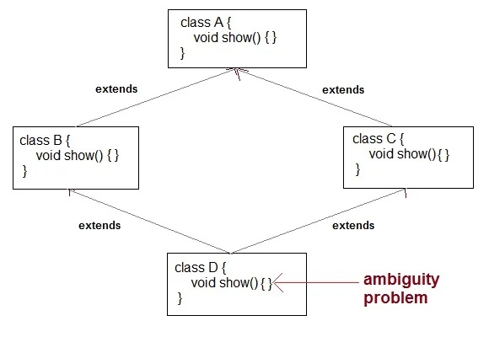
Why multiple inheritance is not supported in Java?
To remove ambiguity.
To provide more maintainable and clear design.

Slide 7
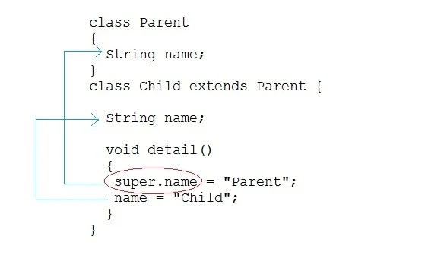
super keyword
In Java, super keyword is used to refer to immediate parent class of a child class.
In other words super keyword is used by a subclass whenever it need to refer to its immediate super class.

Slide 8
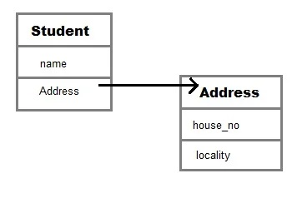
Aggregation (HAS-A relationship)
Aggregation is a term which is used to refer one way relationship between two objects. For example, Student class can have reference of Address class but vice versa does not make sense.

Slide 9
Advantage of using aggregation
The main advantage of using aggregation is to maintain code re-usability.
If an entity has a relation with some other entity than it can reuse code just by referring that.

Slide 10
Composition in Java
Composition is a more restricted form of Aggregation. Composition can be described as when one class which includes another class, is dependent on it in such a way that it cannot functionally exist without the class which is included.
For example a class Car cannot exist without Engine, as it won't be functional anymore.

Slide 11
Q. When to use Inheritance and Aggregation?
When you want to use some property or behavior of any class without the requirement of modifying it or adding more functionality to it, in such case Aggregation is a better option because in case of Aggregation we are just using any external class inside our class as a variable.
Whereas when you want to use and modify some property or behavior of any external class or may be want to add more function on top of it, its best to use Inheritance.

Slide 12
Method Overloading in Java
Method overloading is a concept that allows to declare multiple methods with same name but different parameters in the same class.
Java supports method overloading and always occur in the same class(unlike method overriding).
Method overloading is one of the ways through which java supports polymorphism. Polymorphism is a concept of object oriented programming that deal with multiple forms. We will cover polymorphism in separate topics later on.
Method overloading can be done by changing number of arguments or by changing the data type of arguments.
If two or more method have same name and same parameter list but differs in return type can not be overloaded.
Note: Overloaded method can have different access modifiers and it does not have any significance in method overloading.

Slide 13
Two different ways of method overloading
Different datatype of arguments
Different number of arguments

Slide 14
Method Overriding in Java
Method overriding is a process of overriding base class method by derived class method with more specific definition.
Method overriding performs only if two classes have is-a relationship. It mean class must have inheritance. In other words, It is performed between two classes using inheritance relation.
In overriding, method of both class must have same name and equal number of parameters.
Method overriding is also referred to as runtime polymorphism because calling method is decided by JVM during runtime.
The key benefit of overriding is the ability to define method that's specific to a particular subclass type.

Slide 15
Rules for Method Overriding
1. Method name must be same for both parent and child classes.
2. Access modifier of child method must not restrictive than parent class method.
3. Private, final and static methods cannot be overridden.
4. There must be an IS-A relationship between classes (inheritance).

Slide 16
Example of Method Overriding

Slide 17
Runtime Polymorphism or Dynamic method dispatch
Dynamic method dispatch is a mechanism by which a call to an overridden method is resolved at runtime.
This is how java implements runtime polymorphism. When an overridden method is called by a reference, java determines which version of that method to execute based on the type of object it refer to.
In simple words the type of object which it referred determines which version of overridden method will be called.

Slide 18
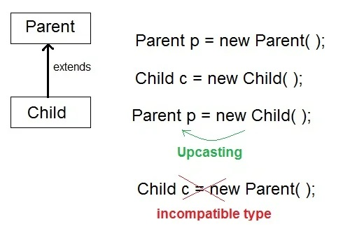
Runtime Polymorphism or Dynamic method dispatch

Slide 19
What is Abstraction in OOPs? Java Abstract Class & Method
Abstraction is the concept of object-oriented programming that “shows” only essential attributes and “hides” unnecessary information.
The main purpose of abstraction is hiding the unnecessary details from the users.
Abstraction is selecting data from a larger pool to show only relevant details of the object to the user.
It helps in reducing programming complexity and efforts.
It is one of the most important concepts of OOPs.

Slide 20
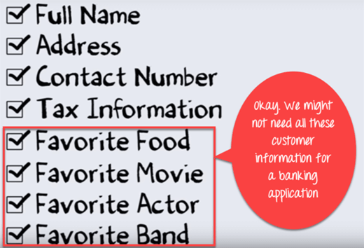

Let’s Study Abstraction in OOPs with example

Slide 21
Difference between Abstraction and Encapsulation
Abstraction | Encapsulation
Abstraction in Object Oriented Programming solves the issues at the design level. | Encapsulation solves it implementation level.
Abstraction in Programming is about hiding unwanted details while showing most essential information. | Encapsulation means binding the code and data into a single unit.
Data Abstraction in Java allows focussing on what the information object must contain | Encapsulation means hiding the internal details or mechanics of how an object does something for security reasons.

Slide 22
Difference between Abstract Class and Interface
Abstract Class | Interface
An abstract class can have both abstract and non-abstract methods. | The interface can have only abstract methods.
It does not support multiple inheritances. | It supports multiple inheritances.
It can provide the implementation of the interface. | It can not provide the implementation of the abstract class.
An abstract class can have protected and abstract public methods. | An interface can have only have public abstract methods.
An abstract class can have final, static, or static final variable with any access specifier. | The interface can only have a public static final variable.

Slide 23

What is Abstract Class?
Abstract Class is a type of class in OOPs, that declare one or more abstract methods. These classes can have abstract methods as well as concrete methods. A normal class cannot have abstract methods. An abstract class is a class that contains at least one abstract method.

Slide 24
What are Abstract Methods?
Abstract Method is a method that has just the method definition but does not contain implementation. A method without a body is known as an Abstract Method. It must be declared in an abstract class. The abstract method will never be final because the abstract class must implement all the abstract methods.

Slide 25
Advantages of Abstraction
The main benefit of using an Abstraction in Programming is that it allows you to group several related classes as siblings.
Abstraction in Object Oriented Programming helps to reduce the complexity of the design and implementation process of software.

Slide 26

When to use Abstract Methods & Abstract Class?
Abstract methods are mostly declared where two or more subclasses are also doing the same thing in different ways through different implementations. It also extends the same Abstract class and offers different implementations of the abstract methods.
Abstract classes help to describe generic types of behaviors and object-oriented programming class hierarchy. It also describes subclasses to offer implementation details of the abstract class.

Slide 27

What is Encapsulation in Java?
Encapsulation in Java is a mechanism to wrap up variables(data) and methods(code) together as a single unit.
It is the process of hiding information details and protecting data and behavior of the object.
It is one of the four important OOP concepts.
The encapsulate class is easy to test, so it is also better for unit testing.

Slide 28
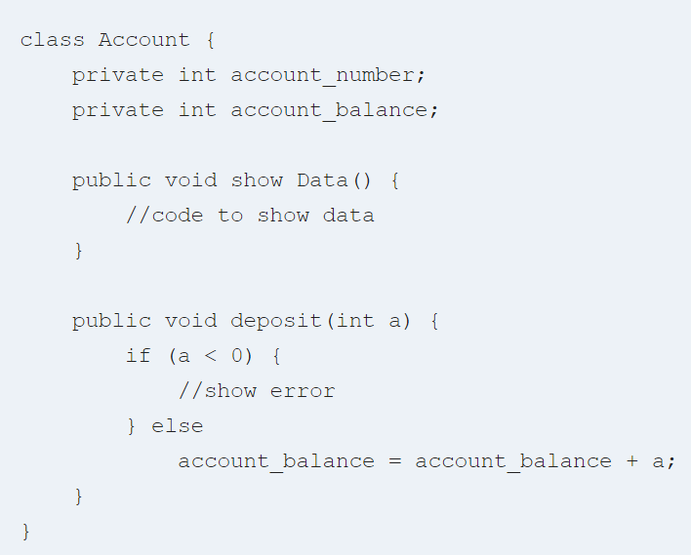
Learn Encapsulation with an Example
To understand what is encapsulation in detail consider the following bank account class with deposit and show balance methods

Slide 29

Data Hiding in Java
Data Hiding in Java is hiding the variables of a class from other classes. It can only be accessed through the method of their current class. It hides the implementation details from the users. But more than data hiding, it is meant for better management or grouping of related data.
To achieve a lesser degree of encapsulation in Java, you can use modifiers like “protected” or “public”. With encapsulation, developers can change one part of the code easily without affecting other.

Slide 30
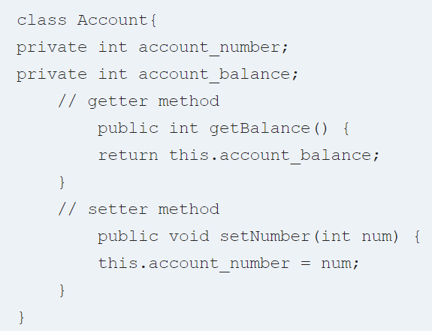
Getter and Setter in Java
Getter and Setter in Java are two conventional methods used to retrieve and update values of a variable. They are mainly used to create, modify, delete and view the variable values. The setter method is used for updating values and the getter method is used for reading or retrieving the values. They are also known as an accessor and mutator.

Slide 31

Abstraction vs. Encapsulation
Often encapsulation is misunderstood with Abstraction. Lets study-
Encapsulation is more about “How” to achieve a functionality
Abstraction is more about “What” a class can do.
A simple example to understand this difference is a mobile phone. Where the complex logic in the circuit board is encapsulated in a touch screen, and the interface is provided to abstract it out.

Slide 32

Advantages of Encapsulation in Java
Encapsulation is binding the data with its related functionalities. Here functionalities mean “methods” and data means “variables”
So we keep variable and methods in one place. That place is “class.” Class is the base for encapsulation.
With Java Encapsulation, you can hide (restrict access) to critical data members in your code, which improves security
As we discussed earlier, if a data member is declared “private”, then it can only be accessed within the same class. No outside class can access data member (variable) of other class.
However, if you need to access these variables, you have to use public “getter” and “setter” methods.

Slide 33
Garbage Collection in Java
Java garbage collection is the process of releasing unused memory occupied by unused objects. This process is done by the JVM automatically because it is essential for memory management.
When a Java programs run on the JVM, objects are created on the heap, which is a portion of memory dedicated to the program. Eventually, some objects will no longer be needed.
When there is no reference to an object, then that object is assumed to be no longer needed and the memory occupied by the object are released. This technique is called Garbage Collection.

Slide 34
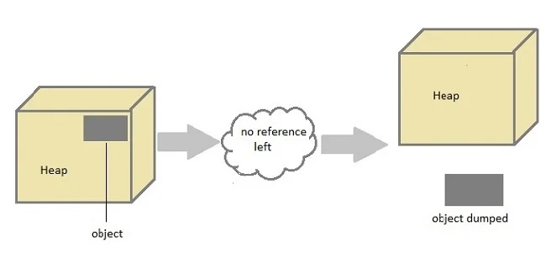
How Garbage Collection Works?

Slide 35

Can the Garbage Collection be forced explicitly ?
No, the Garbage Collection cannot be forced explicitly. We may request JVM for garbage collection by calling System.gc() method
But This does not guarantee that JVM will perform the garbage collection.

Slide 36
Advantages of Garbage Collection
Programmer doesn't need to worry about dereferencing an object.
It is done automatically by JVM.
Increases memory efficiency and decreases the chances for memory leak.

Slide 37
We can make an object non-reference by using three ways
set null to object reference which makes it able for garbage collection.
We can non-reference an object by setting new reference to it which makes it able for garbage collection.
Anonymous object does not have any reference so if it is not in use, it is ready for the garbage collection.

Slide 38
finalize() method
Sometime an object will need to perform some specific task before it is destroyed such as closing an open connection or releasing any resources held. To handle such situation finalize() method is used.
The finalize() method is called by garbage collection thread before collecting object. Its the last chance for any object to perform cleanup utility.

Slide 39
Some Important Points to Remember
It is defined in java.lang.Object class, therefore it is available to all the classes.
It is declare as proctected inside Object class.
It gets called only once by a Daemon thread named GC (Garbage Collector) thread.

Slide 40
Request for Garbage Collection
We can request to JVM for garbage collection however, it is upto the JVM when to start the garbage collector.
Java gc() method is used to call garbage collector explicitly. However gc() method does not guarantee that JVM will perform the garbage collection. It only request the JVM for garbage collection. This method is present in System and Runtime class.

